Slide 2
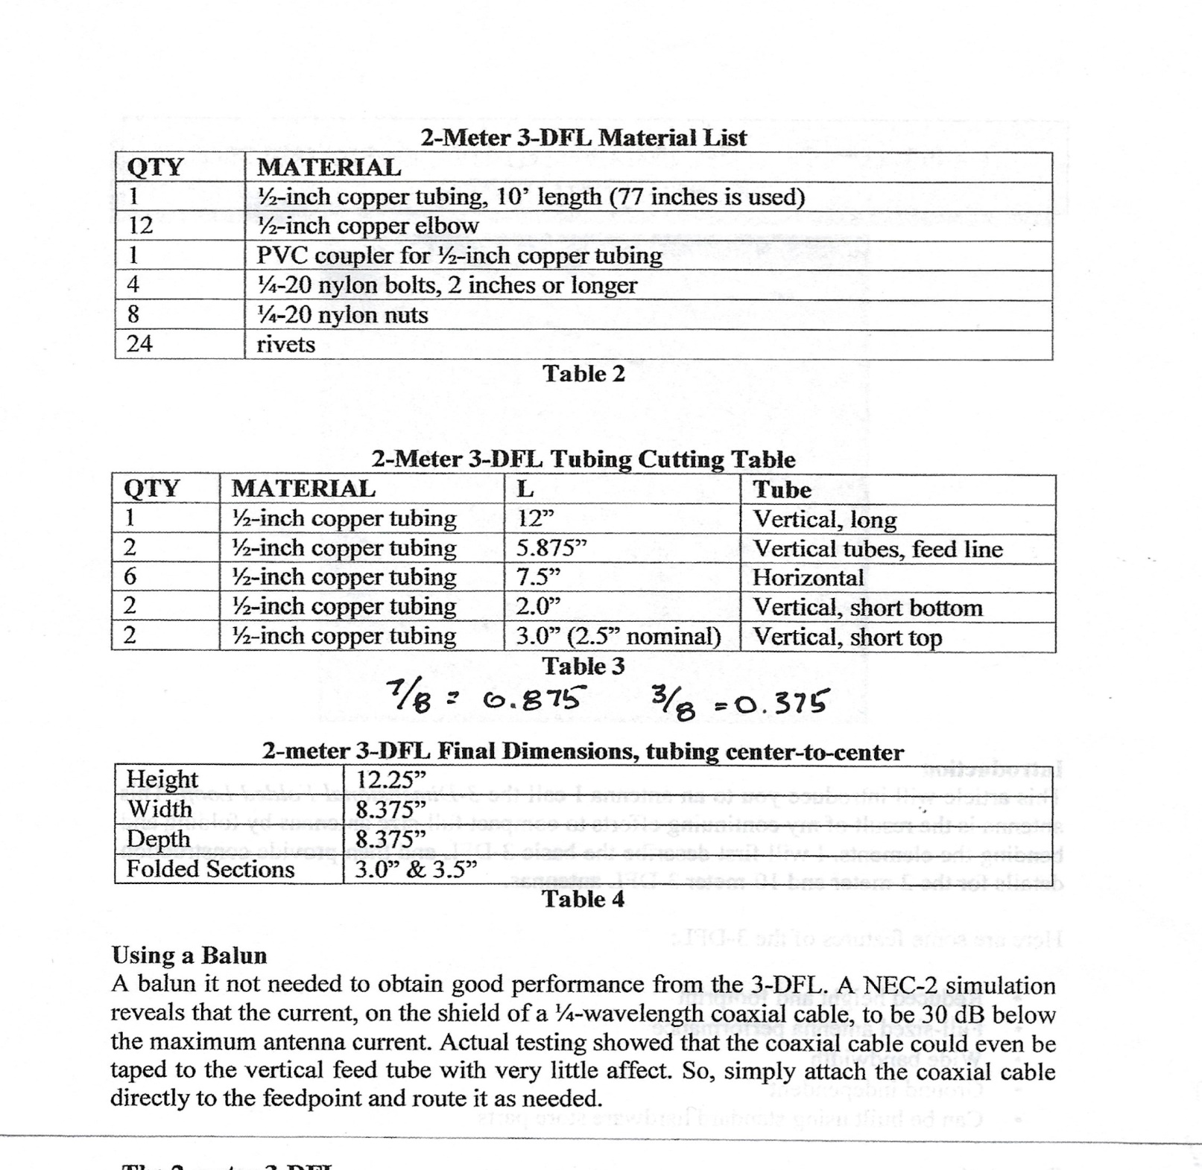

Slide 3
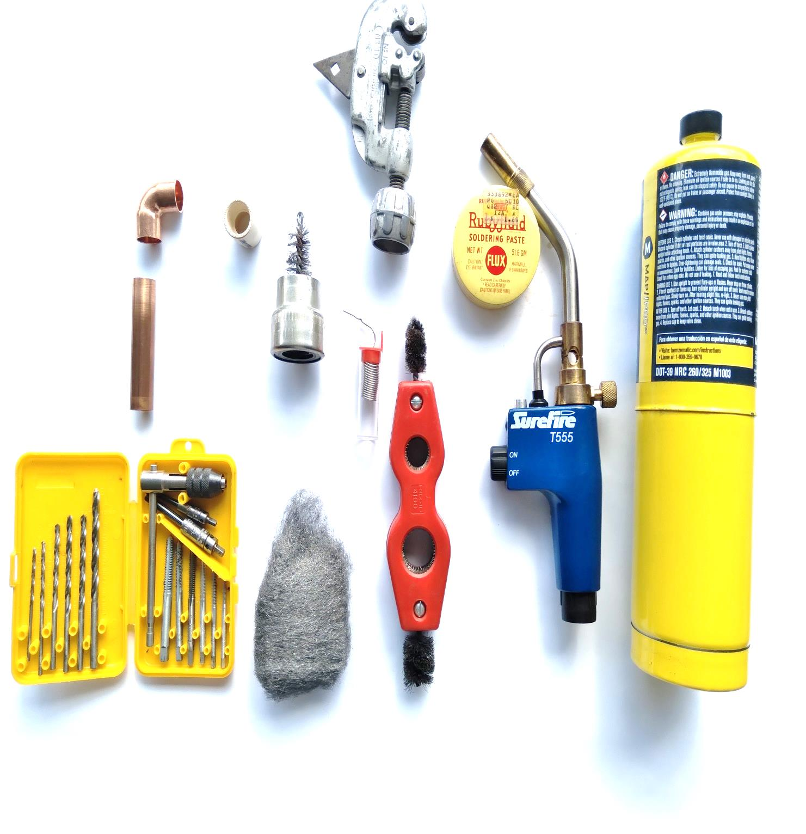
TOOLS NEEDED;
Propane torch
Ruby Red Flux
Tubing Cutter with Chamfer reamer
Cleaning Brush
Rosin Core Solder
Tap & Drill for 6/32 screw
Material;
7. PVC Coupler
8. Elbow
9. Copper Tubing
10. Coaxial Cable
11. PL 259 Connector

Slide 4
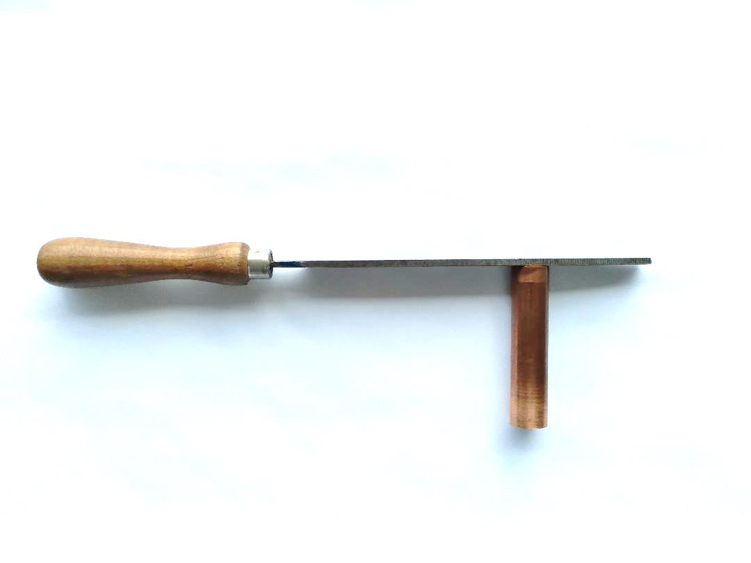
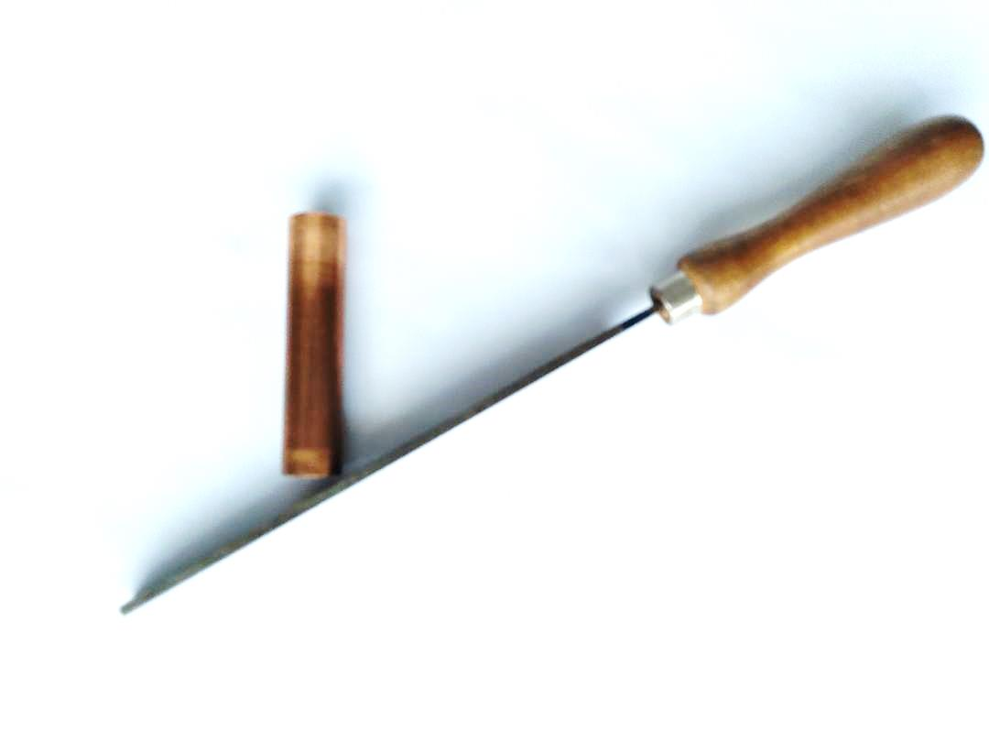
DEBURING THE TUBING;
With a file flatten the surface edge
Follow up with deburring edge

Slide 5
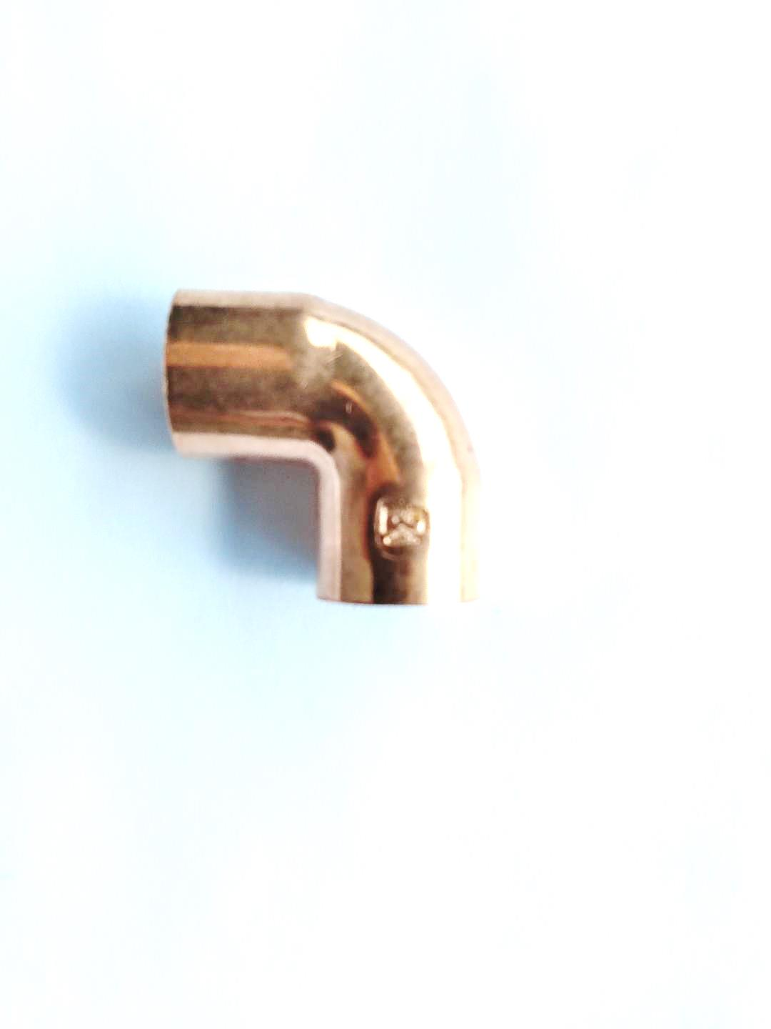
Watch Out for Interference Fits;
Imprints in copper fitting
Edges on copper tubing
Recommend the thicker wall tubing
Once the parts fit and do not bind mark the fitting and tubing for reassembly

Slide 6
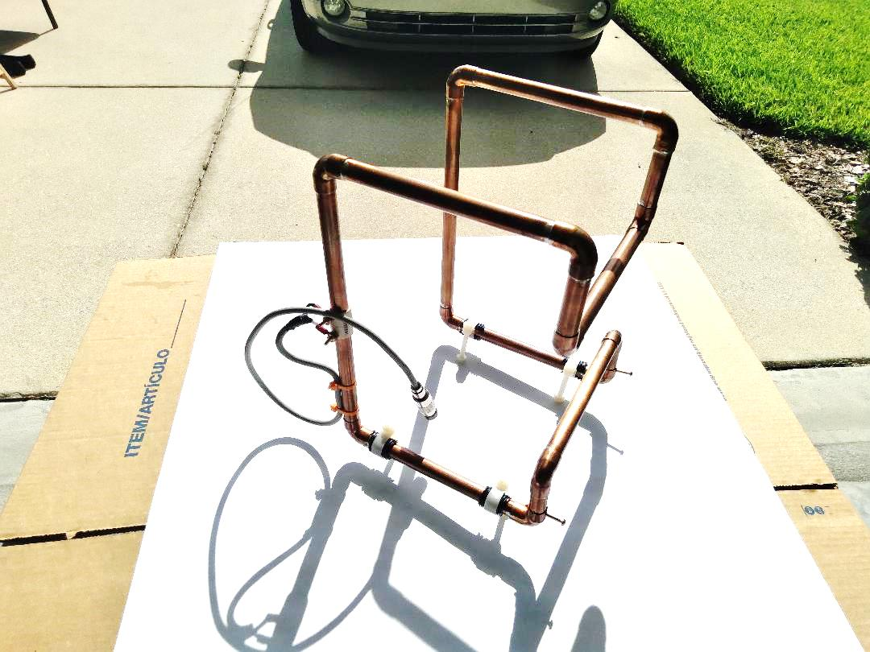
FINAL ASSEMBLY;
Add plastic bolts and nuts
Add coax and connector
Tune;
Adjust the Trombone style tuning device at the bottom of the loop
Once adjusted then solder or leave the screws in place
4 watt HH will hit the repeater
NOTES;
This antenna is very directional. The feed point needs to be in the opposite direction of the repeater location

